Slide 1
Leveraging 5G New Radio for Satellite Communications
Author(s): Nachman Mimoun, Gilad Vaknin
Affiliation: Centre for Wireless Communications (CWC), University of Oulu, Oulu, Finland
Date: September 3, 2020

Slide 2
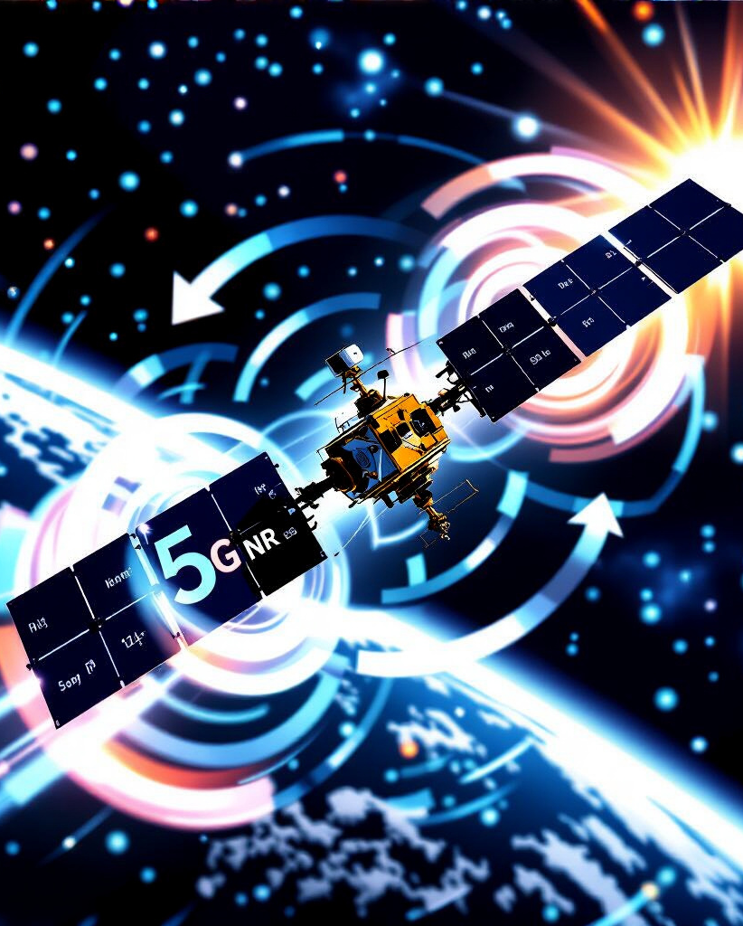
Introduction & Motivation
Problem: Integrating 5G New Radio (NR) with satellite communication (SATCOM) systems faces challenges like large propagation delay, Doppler frequency shift, and high Peak-to-Average Power Ratio (PAPR) of 5G NR signals. Satellite systems prefer to operate at very low power amplifier back-off values.
Aim: Consider the feasibility of 5G NR over satellite links (Non-Terrestrial Networks - NTNs).
Key Aspects Addressed: Initial synchronization, uplink random access, and the relationship between low PAPR and power amplifier back-off, demonstrating that 2-dB back-off values can be achieved with sufficient reference symbol density.

Slide 3
5G NR and SATCOM Integration
Active Research & Standardization: Integration of SATCOM and 5G NR is a current research topic with intense standardization.
Benefits of Integration: Solves coverage issues, temporarily boosts capacity in hotspots, improves interoperability, enables joint signal design and chip manufacturing, and reduces overall costs.
3GPP Standardization: Termed Non-Terrestrial Networks (NTNs); first results expected in Release 17 (2021).
Integration Levels:
Using existing legacy satellite networks (slicing, network function virtualization).
At the signal level, where satellite systems directly use the 5G NR interface.
Use Cases: Direct end-user access or backhaul solution.

Slide 4
Satellite System Characteristics & Challenges
Orbits and Delays
Doppler Frequency Shift
Propagation Delay
GEO: ~35,800-km altitude, ~120 ms one-way delay. Insignificant Doppler.
MEO: 2,000-km to GEO, 7-120 ms delay.
LEO: 160-2,000 km, 0.5-7 ms delay.
HEO: Elliptical route, varying delay.
Significant for LEO, MEO, and HEO satellites due to their movement relative to Earth.
Example: LEO at 600-km altitude, 30 GHz carrier frequency: ±720 kHz max Doppler, -8.16 kHz/s max Doppler shift variation.
All satellite systems exceed terrestrial system propagation delays, posing a problem for uplink random access.

Slide 5

Standard 5G NR Limitations
Uplink Random Access: Challenges and Solutions
Main Problems:
Much longer propagation delay for uplink random access.
Larger Doppler frequency shift for detecting the uplink random access signal.
Uplink Random Access Process: NTN terminal sends PRACH signal, gNB calculates Timing Advance (TA) and sends it in Random Access Response (RAR).
Issues with Existing 5G NR Standard:
Maximum TA value (2 ms at 15-kHz SCS) is insufficient for all satellite systems. Requires modifications to TA calculation at gNB and its transmission.
RAR message needs to be adjusted for more TA bits.
PRACH guard interval needs to be extended.

Slide 6
Proposed Solutions
Experimental Verification (SaT5G)
Proposed Solutions/Adjustments:
Adjusting timer durations for propagation delays.
Extending guard interval (vendor-specific scheduler redesign).
Using common minimum delay (differential delay) to reduce reported delay range, though still insufficient due to large satellite footprint.
Modified TA calculation and transmission, extended timers, and increased guard interval enabled successful connection formation with emulated satellite links.
Downlink Synchronization and CFO Compensation
Challenge: Large Doppler frequency shifts cause Carrier Frequency Offset (CFO) at the receiver.
Impact: A typical receiver fails to properly detect the Synchronization Signal (SS) on downlink or PRACH on uplink if CFO is too large.

Slide 7
Proposed Solutions
Signal Processing Improvements
Signal Processing: New PRACH, CFO-aware methods, longer signals, extended PRACH.
Multiarm Receiver
Multiarm Receiver: For initial CFO estimation; meets 5G NR PSS detection at -6 dB SNR/RE.
Network Assistance
Network-Assisted: gNBs send CFO corrections.

Slide 8
Feasibility & Performance
Feasibility: Proposed solutions do not require significant standard changes, but NTN transceivers must account for Doppler frequency shifts.
Performance: Multiarm receiver can detect PSS signal with probability one at -6-dB SNR/RE, meeting 5G NR requirements.
Data Reception with Low PAPR
Challenge: High Power Amplifiers (HPAs) in satellite systems are expected to operate close to saturation, but 5G signals have a high dynamic range (high PAPR).
Benefits of Low PAPR & Low HPA Back-off: Enhance communication range, received signal level (SNR), and HPA power efficiency – crucial for satellites with limited power.

Slide 9
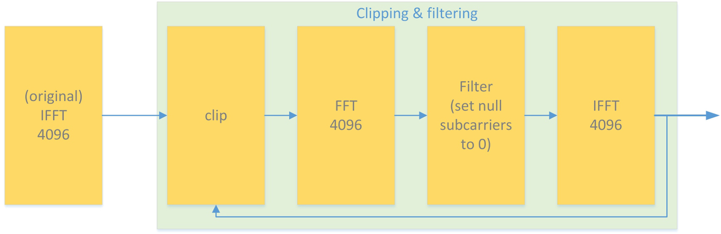
PAPR Reduction (PAPR-R)
ICF:
Iterative Clipping and Filtering (ICF): Suitable for 5G NR, nulls out-of-band subcarriers after clipping iteratively.
Clipping causes undesired out-of-band radiation and noise.
Satellite System Requirements:
Current satellite standard DVB-S operates at ~0 dB output back-off (OBO). 5G NR often sees 6-dB PAPR with reduction, >10 dB without.
Key Efficiency:
Reducing HPA OBO from 6 dB to 2 dB can improve efficiency by 30%.

Slide 10
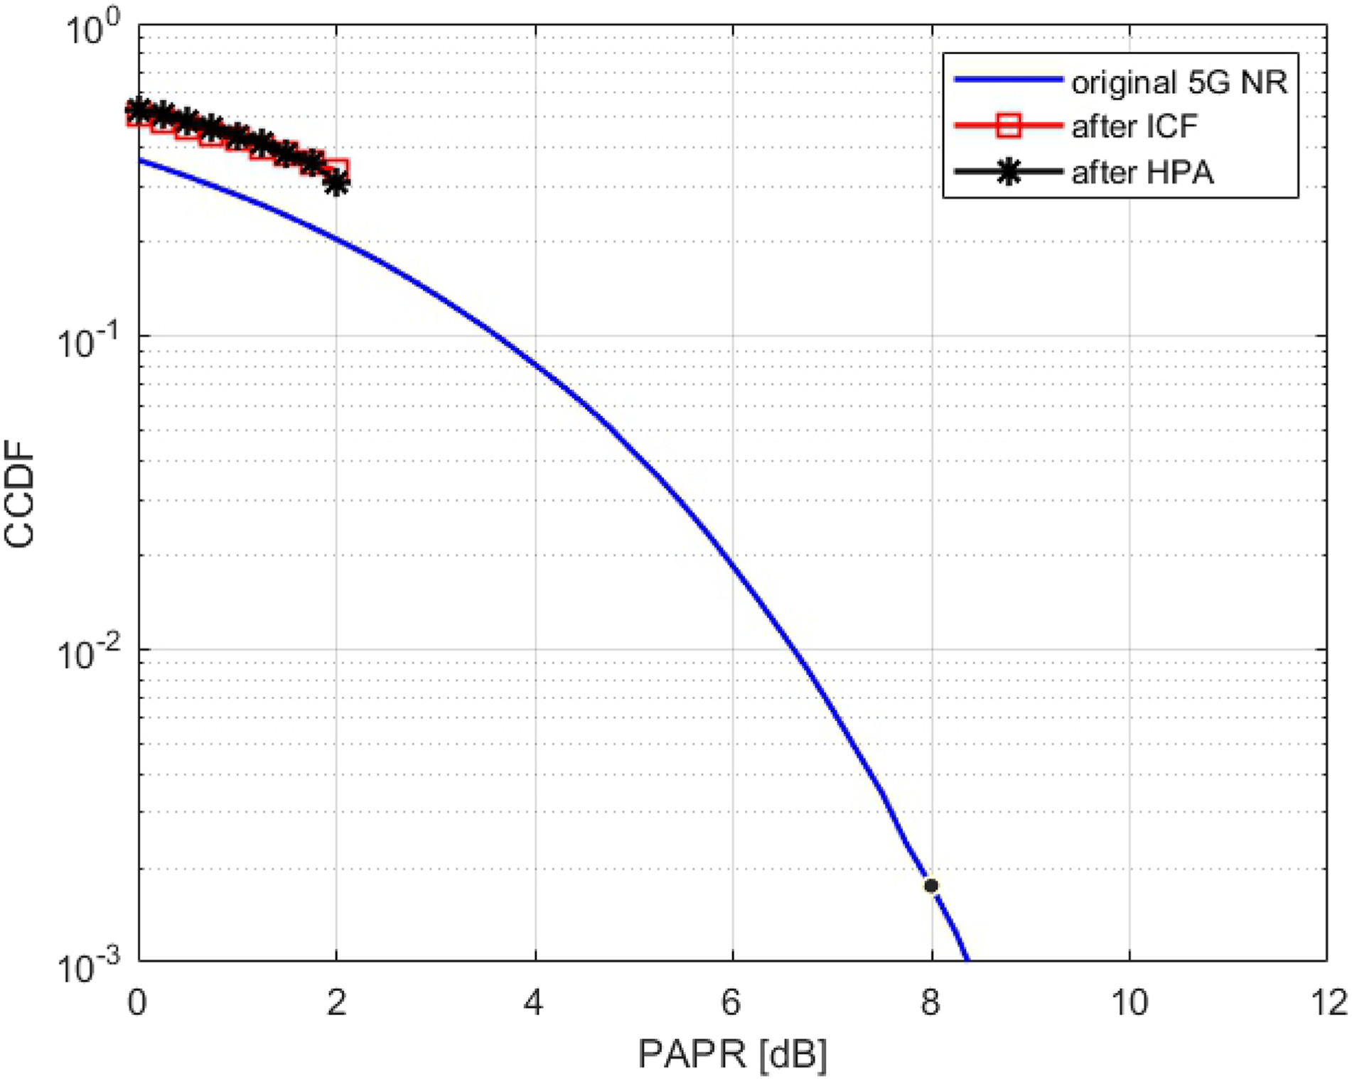
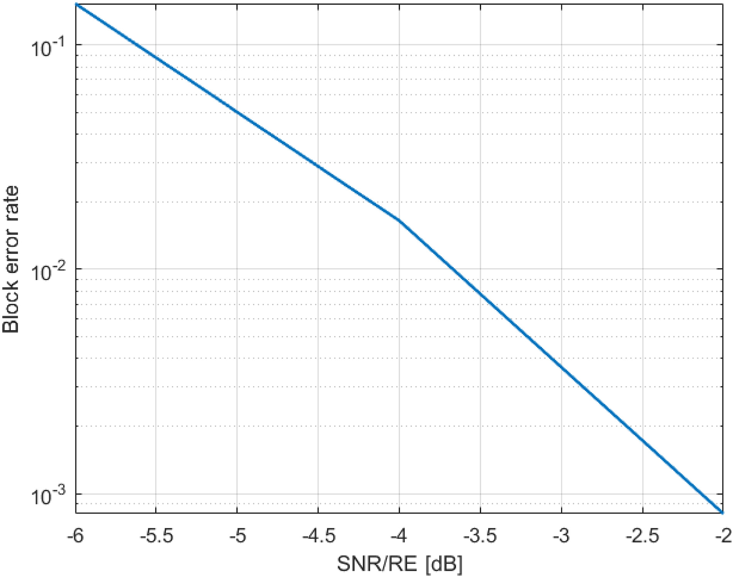
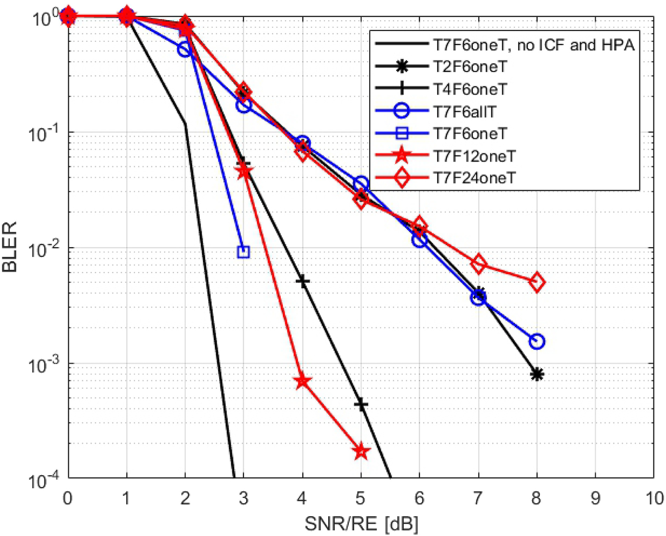
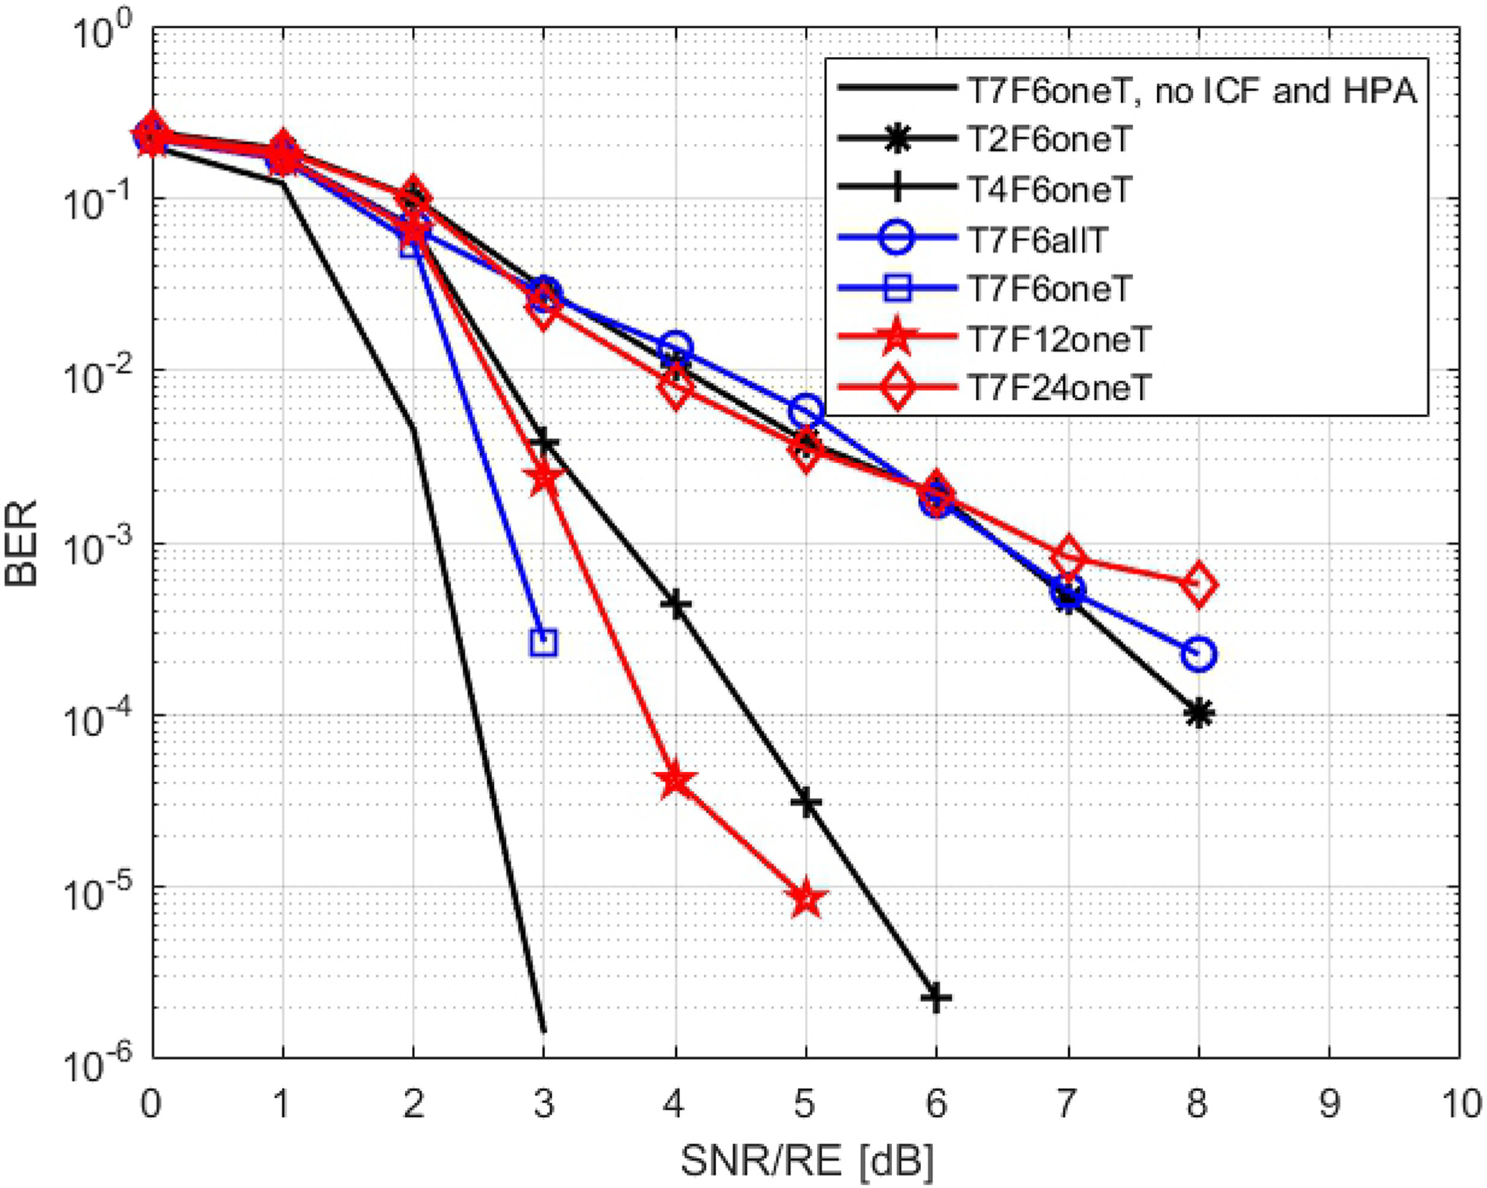
Simulation Results: PAPR and Reference Symbol Density
Simulation Setup:
Single path radio channel with Gaussian noise.
Simulated signal includes SS block and data slots.
Doppler shift and change rate modeled as uniform random variables (±720 kHz and ±8 kHz/s).
DMRS (Demodulation Reference Symbols) density varied in time and frequency domains.
ICF used for PAPR reduction, target PAPR of 2 dB, HPA OBO set to 2 dB.
PAPR Reduction Performance: ICF effectively reduces PAPR to 2 dB, and HPA does not increase it with this configuration.
Notes:
Setup Channel: Single path, Gaussian noise.
Signal: SS block, data slots.
Doppler: ±720 kHz, ±8 kHz/s.
DMRS Density: Varied in time/frequency.
PAPR Reduction: ICF (3 iterations), target PAPR 2 dB, HPA OBO 2 dB.
Modulation: QPSK.

Slide 11

Impact of DMRS Density (BLER/BER Results):
Higher DMRS density in the time domain is beneficial (e.g., T7F6oneT outperforms T2F6oneT).
Increasing DMRS density can achieve performance comparable to ideal cases (losses vanish above 4 dB SNR/RE).
Denser DMRS spread in the frequency domain is also beneficial.
Temporal integration of RSs is not a good idea, possibly due to CFO tracking issues caused by clipping.

Slide 12
Overall Conclusion
Feasibility of 5G NR in SATCOM: Standard 5G NR data transmission is feasible for satellite systems.
Required Adjustments:
Current standards need adjustments for SATCOM-specific requirements (e.g., max CFO).
Vendors must address practical problems like handling large CFO in receivers.
Operators need to configure suitable DMRS density and potentially limit modulation order and coding rates.

Slide 13
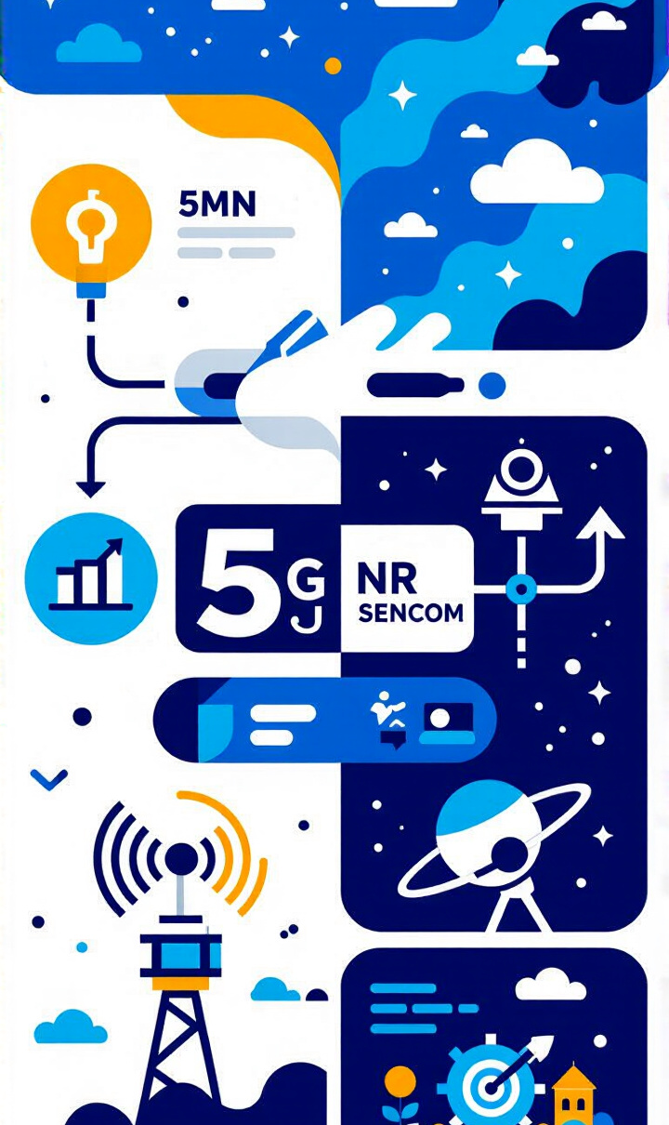
Conclusions
Achieved Outcomes:
Addressed TA calculation/transmission, PRACH guard interval, and initial access.
Investigated RS density's effect on performance.
Reducing PAPR to 2-dB level boosts 5G NR power amplifier efficiency for satellite links.
Successfully transmitting 5G NR signal with low MODCOD values through nonlinear HPA with low back-off, emphasizing PAPR reduction and limiting out-of-band emissions before HPA.

Slide 14
Future Research Directions
Future Research Directions:
Optimization & Study:
Optimal RS density/equalization.
Lowest clipping level.
RS power allocation impact.
Better low-complexity PAPR-R schemes.
Higher order modulations/BPSK with low PAPR.
Data block length/coding rate effects.

Slide 15
Thank you!

